Slide 1

Supervised by Dr. Amin Allam
TA. Khloud Khaled
Implemented by
20170369 | Nada Nasser Al-Saeed
20170351 | Farah Mohamed Osama
20170352 | Hussien Hossam Idris
20170345 | Yousef Adel El-Sayed
20170363 | Omar Ashraf Labib
Graduation Project
Academic Year 2020-2021
Final Presentation

Slide 2
A twist on e-commerce applications

Slide 3
Introduction

Slide 4

Motivation
E-COMMERCE HAS BROGUHT MANY BENNIFITS
EXTEND UPON THESE BENEFITS
ENHANCE USER EXPERIENCE

Slide 5

objectives
BUILD AN E-COMMERCE APPLICATION
HAS THE KNOWN E-COMMERCE FEATURES
USING NEW AND TRENDING TECHNOLOGIES

Slide 6

waterfall methodology
requirements are gathered at the beginning.
a linear project management approach.
broke down the project phases.
each phase depended on the previous phase.

Slide 7

Functional requirments

Slide 8
basic e-commerce requirements
Authentication system
BROWSING and searching of PRODUCTS
user shopping carts
user wish lists
adding products to carts

Slide 9
THE APPLICATION HELPER
interacted with using text or voice
Receives commands in Arabic
can search for products
can add items to carts
navigate through the application

Slide 10
Monthly carts
Alleviate the repetitive buying process
items are delivered every month
can apply crud operations on them
can be re-scheduled or canceled anytime
can have up to three carts

Slide 11
Expense tracker
visualizes monthly expenses
detailed records on the user’s transactions
based on product categories and dates

Slide 12
The friend and gifting system
makes the gifting process more convenient
• add friends using the friend code
• friends can see each other’s wish-lists
order items from their wish-lists.

Slide 13

non-functional requirments

Slide 14

response time
Overall system latency less than 10s.
Searching should take less than 10s.
Takes less than 10s for user validation.

Slide 15

throughput
Database handles 100,000 read/write.
Database queries take less than 5s.

Slide 16

scalability
Application can handle increasing workload.
Database allows unlimited registered users.
Addition of new products.

Slide 17

Security
Email verification for user registration.
Database rules.
Face recognition for admin interface.
API key for admin interface.

Slide 18

usability
Easy to use interface.
Voice commands make searching easier.
App helper takes commands in Arabic.

Slide 19

Reliability
System can handle invalid inputs.
App helper shows clear error messages.

Slide 20
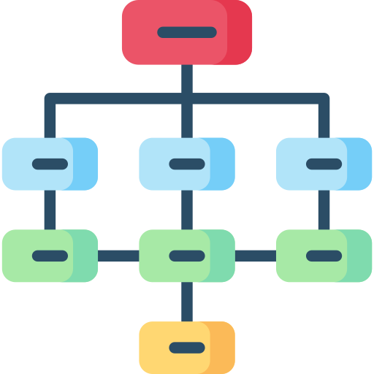
supportability
Adaptability :- system accepts addition .
Maintainability :- system can adapt to change.

Slide 21

implementation

Slide 22




Mobile Application
Flutter SDK for application front end.
Firebase is a Backend-as-a-Service (Baas).
Google Cloud Platform services.
Python language and libraries.

Slide 23


Admin interface
Node.js for back-end.
Html, CSS, JS for front-end.
Firebase is a Backend-as-a-Service (Baas).
Python language and libraries.

Slide 24


other
Github for version control.
Software idea modeler for UML.

Slide 25

Future work and conclusion

Slide 26
future work
Implement a custom voice recognition model.
Establish an interface for delivery workers.
Add an online payment.
Identify brand-less items using image recognition.

Slide 27
future work
Build a recommendation system.
Improve accuracy of app helper.
Delivery period can be specified.

Slide 28
Conclusion
New functionality.
More appealing.
Easier to deal with.

Slide 29

THANK YOU FOR LISTENING

